Slide 1

Using Splunk – A Case Study
CIS 6395, Incident Response Technologies
Fall 2022, Dr. Cliff Zou
changchun.zou@cucf.edu

Slide 2

Acknowledgement
This case study comes from textbook:
Network Forensics: Tracking hackers through cyberspace, by Sherri Davidoff and Jonathan Ham. Prentice Hall; June 23, 2012
I have uploaded this lecture’s case study file, ‘NetworkForensics-Ch8-EventLogs.zip’, on webCourse

Slide 3
Case Scenario and Network Environment
Bob’s Dry cleaner was attacked
The Cleaner’s network consists of:
Internal network: 192.168.30.0/24
DMZ (demilitarized zone): 10.30.30.0/24
DMZ is usually used to host web server that needs to accept outside connections (but less secure)
The outside “Internet”: 172.30.1.0/24 (simplified for case study; all Internet side traffic belongs to this subnet)

Slide 4
Case Scenario and Network Environment
List of important systems in the company:
Hostname | Description | IP address(es)
Ant-fw | Cisco ASA firewall | 192.168.30.10 10.30.30.10 172.30.1.253
Baboon-srv | Linux Server running SSH, NTP, DNS | 10.30.30.20
Cheetah-srv | Server running rsyslogd | 192.168.30.30
Dog-ws | Workstation | 192.168.30.101
Elephant-ws | Workstation | 192.168.30.102
Fox-ws | Workstation | 192.168.30.100
Yak-srv | Server | 192.168.30.90

Slide 5

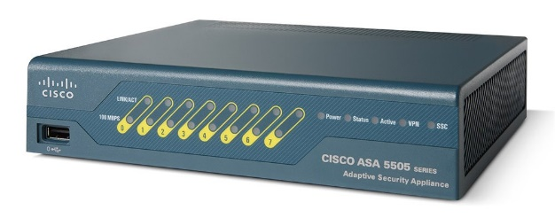


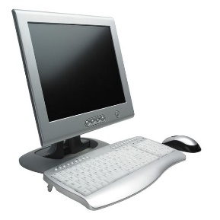
Case Scenario and Network Environment
Ant-fw
Baboon-srv
172.30.1.253
10.30.30.10
192.168.30.10
10.30.30.20
Cheetah-srv
Dog-ws
Elephant-ws
Fox-ws
Yak-srv
192.168.30.30
192.168.30.90

Slide 6
Security Event Logs in the Case Study
The log data contains:
Auth.log: system authentication and privileged command logs from the Linux server, baboon-srv
Workstations.log: logs from Windows workstations
Firewall.log: cisco ASA firewall logs
The Cleaner company’s IT staff noticed a sudden burst of failed login attempts to the ‘baboon-srv’, beginning 18:56:50 on April 27, 2011, so they began investigation

Slide 7
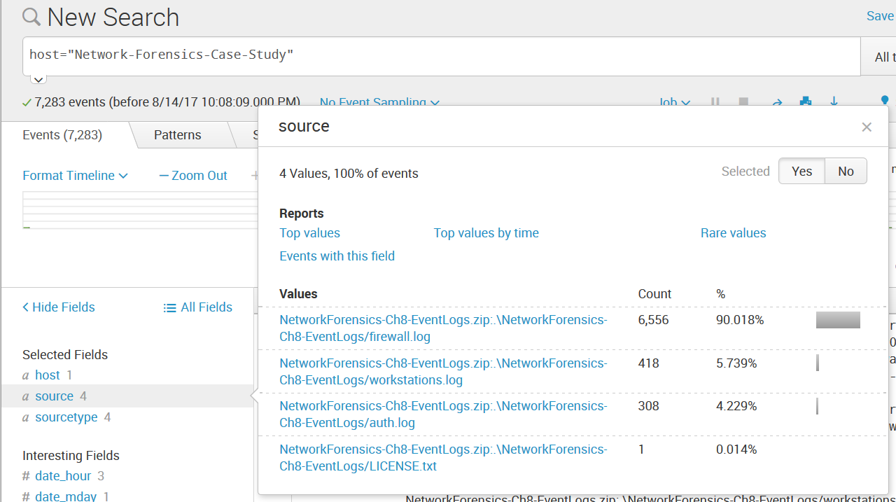
Pre-Analysis: Load log data into Splunk
In Splunk, use ‘add data’, and add the log .zip file in, let us name it “Network-Forensics-Case-Study”
You can see there are 4 data sources:

Slide 8
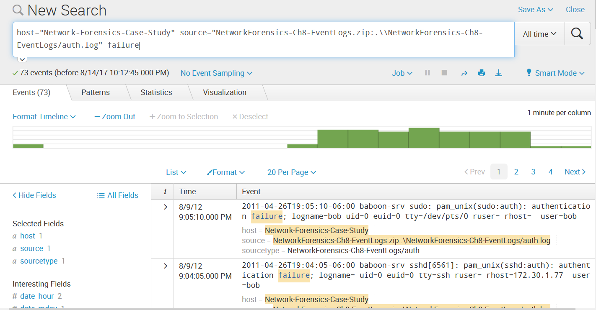
Analysis: First Steps
Check logs related to failed login attempts to Linux server baboon-srv
After loading the .zip data, select only the auth.log, and search for “failure”

Slide 9
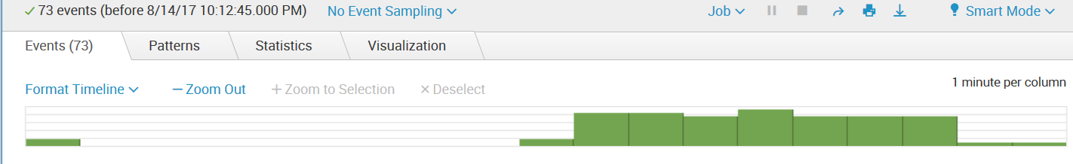
Analysis: First Steps
We can see that the remote host 172.30.1.77 attempted to login to the SSH server on baboon-srv for 73 times.
Using the ‘zoom out’ to check the histogram, we can see that about 70 failed login attempts happened within 7 minutes
That attacking host tried username of ‘bob’ and ‘root’ for these failed login attempts

Slide 10
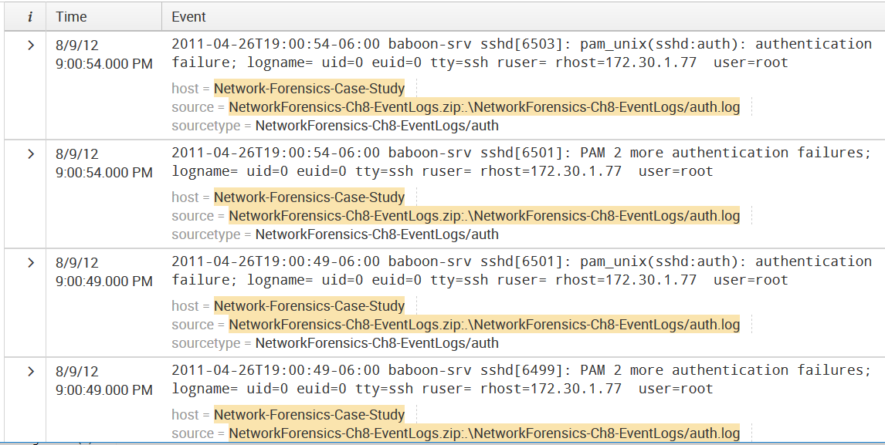
Analysis: First Steps
There are two types of matching failed login events:
One records one login attempt
The other records two login attempts
Attacker’s IP is 172.30.1.77

Slide 11
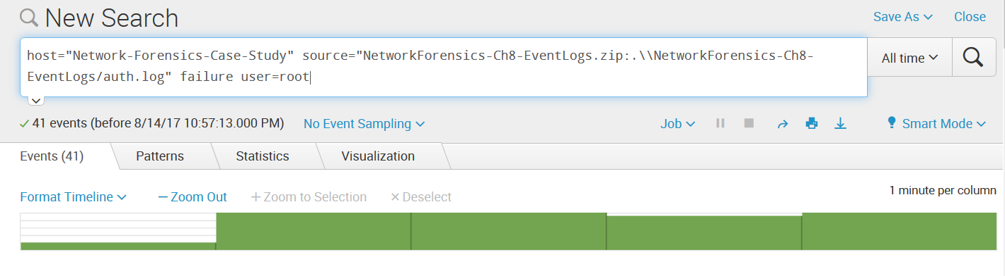
Visualize Failed Login Attempts
Let us just check ‘root’ failed login by adding ‘user=root’ in the search
The search uses regular expressions to define search terms

Slide 12
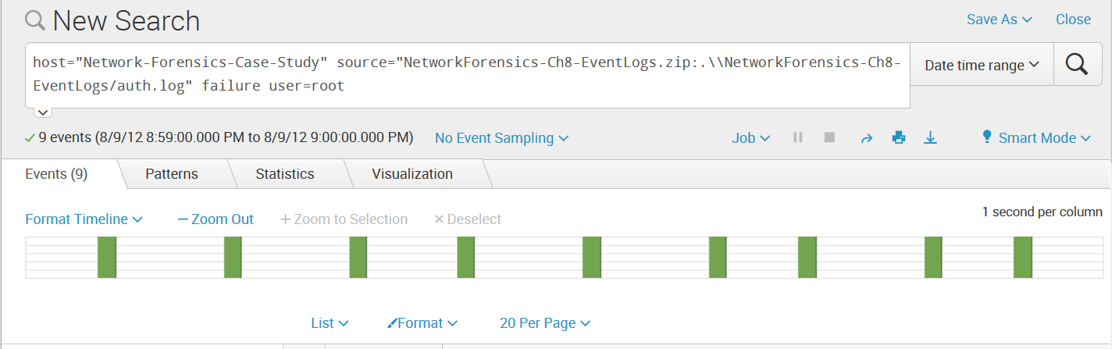
Visualize Failed Login Attempts
Let us zoom in to login attempts within one minute period (by double clicking a column in the histogram)
Regular pattern of two log events every six seconds
This regularity is a strong indicator of using a brute-force password-guessing attack tool.

Slide 13
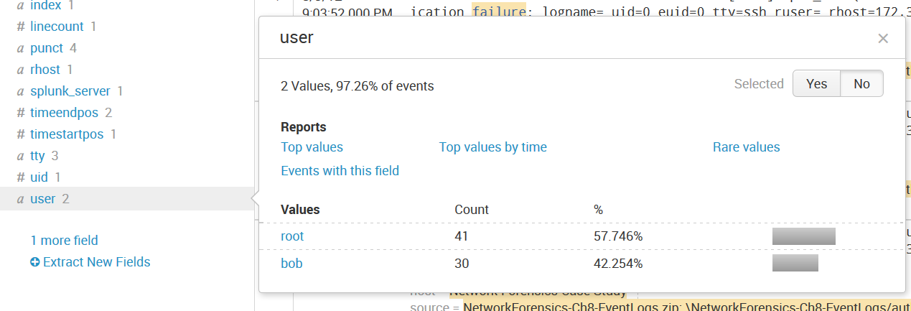
Targeted Accounts
Q: what accounts were targeted? Was the attack successful?
When we return to search of ‘failure’ on ‘All time’ period, check the ‘Interesting fields’ and find ‘user’ field

Slide 14
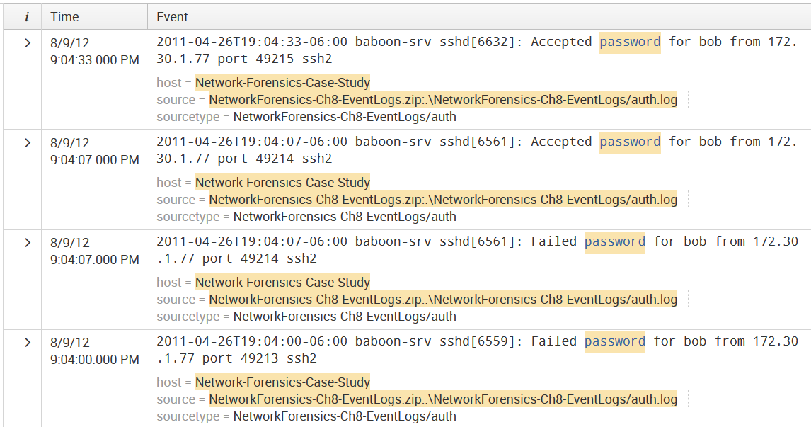
Successful Logins
Q: Whether the attack was successful?
Use the search phrase ‘password’, we found bob password was cracked (at 8/9/12 9:04:07.000PM)!

Slide 15
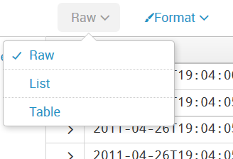
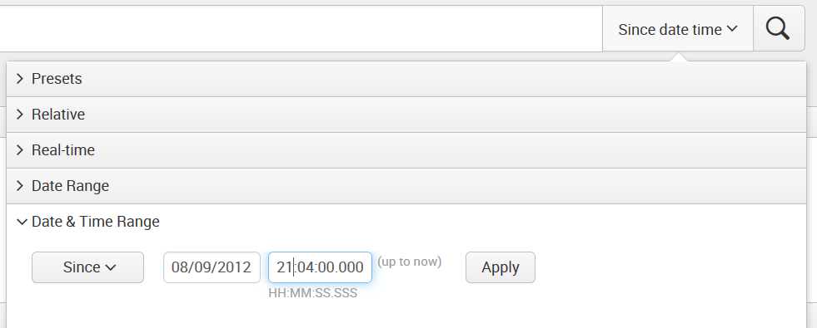
Activities Following Compromise
List search result:
In reverse order (oldest to newest), by appending “|reverse” in the search phrase
Change the list format from ‘list’ to ‘raw’ data format
It makes the event looks more concise
Change the time to ‘Date & Time Range’ right after the crack is successful

Slide 16
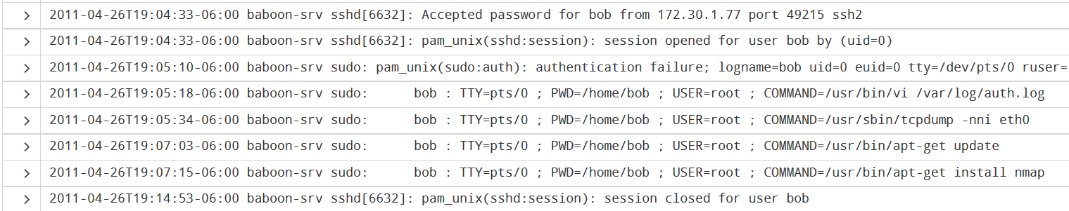
Activities Following Compromise
A first attempt is to run ‘sudo’ by attacker, but failed
Successful execute privileged commands using sudo
Used text editor vi edited local authentication log (but the log was sent to remote log server so it was preserved)
Ran tcpdump
Install nmap for local port scanning
Not all commands are logged in the auth.log file, only privileged commands are logged.
Attacker logged out after 7 minutes (what happened here?)

Slide 17
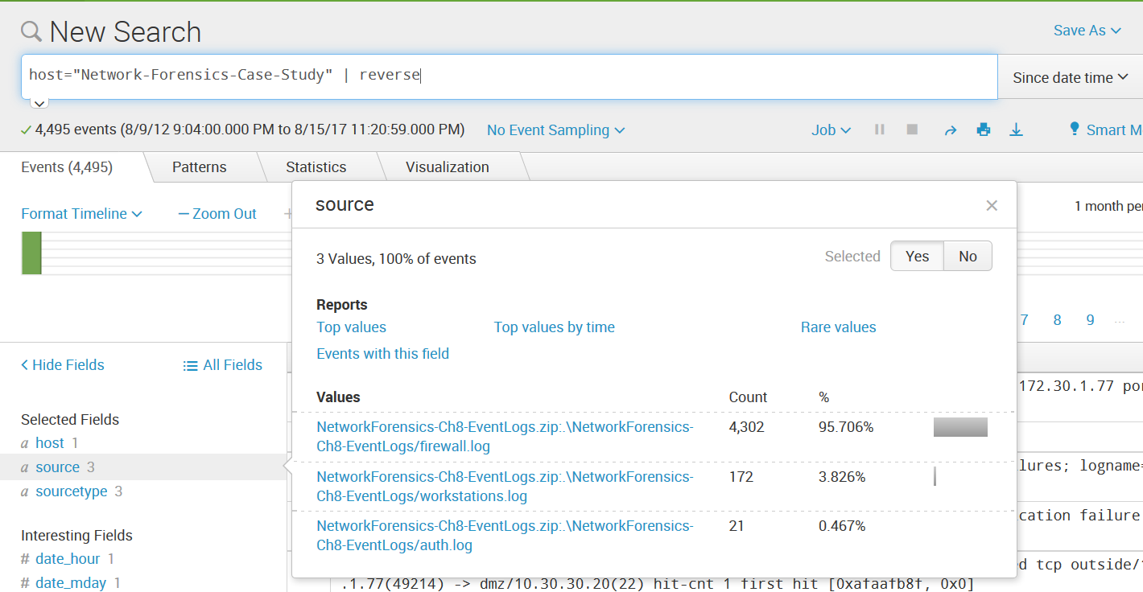
Firewall Logs
Check if we can find evidence of activities relating to baboon-srv during the time frame of interest
We remove the ‘source’ in the search, still keep the time period, then we can select source field to be the firewall.log, and search for the baboon-srv IP 10.30.30.20

Slide 18
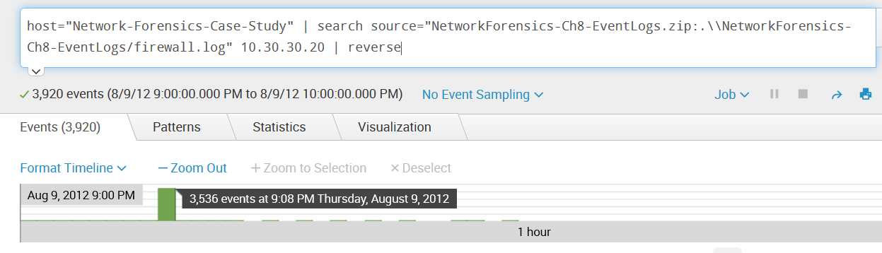
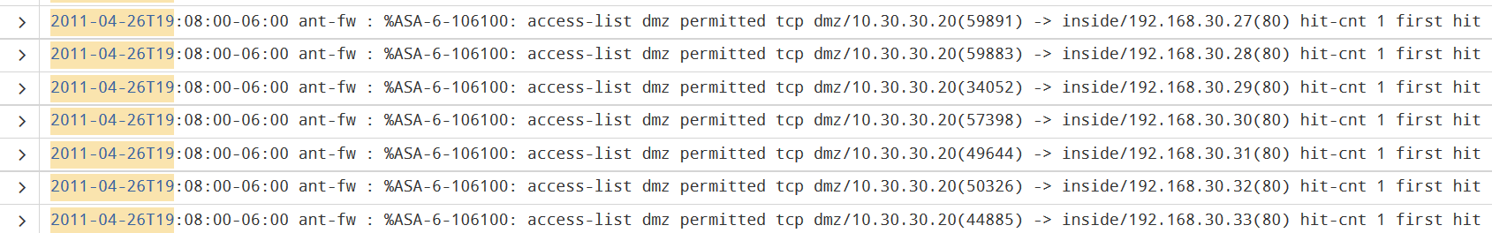
Firewall Logs
There is a sudden spike of activities at 7:08pm in the time frame of interest. The baboon-srv is scanning internal network

Slide 19
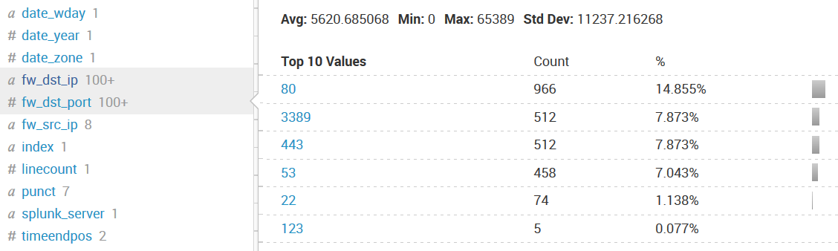
Firewall Logs
But the Splunk does not extract many interesting fields, such as source/dest IP, source/dest port on this firewall log
We need to add these fields in to let Splunk extract them
On left panel, check “Extract New Fields”
The previous introduction slides have introduced how to add new fields
Let us add three fields named as: fw_src_ip, fw_dst_ip, fw_dst_port, you can see they are added to left field panel

Slide 20
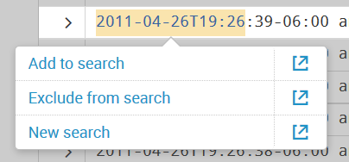
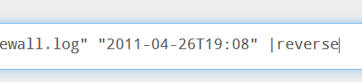
Firewall Logs
Besides changing the search time period, we can also select and click a field in records (e.g., timestamp) to define a search keyword (e.g., timestamp to constrain the time period). You can edit the search phrase.
We are interested in the spike activities happened on 19:08 minute
Don’t forget to add ‘|reverse’ if you want records to follow normal time order

Slide 21
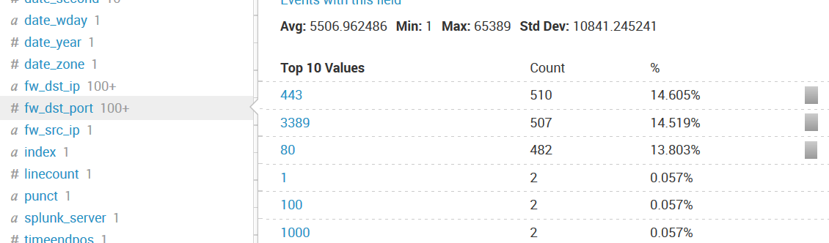
Firewall Logs
We focus on baboon-srv outgoing traffic, so select ‘fw_src_ip’ to only show 10.30.30.20, then we can check ‘fw_dst_port’ to see what destination ports have been scanned by it.
The server scanned both Web service (80, 443) and Remote Desktop service (3389)

Slide 22
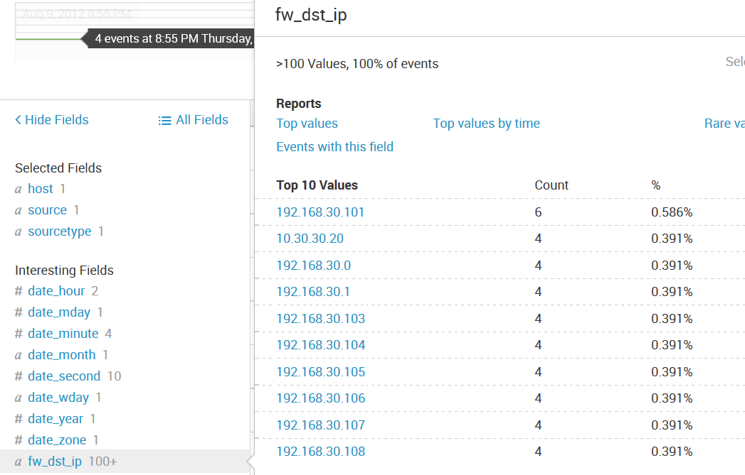
Firewall Logs
Focus on Remote Desktop service (3389) scan. By clicking the 3389 port, and then click the fw_dst_ip field (remove the time constraint in search field)
So, each subnet IP was scanned 4 times. We have 3 internal Windows machine (192.168.30.100 - 102), could any one of them be compromised? Note that 192.168.30.101 was connected 6 times!
But, the firewall log cannot tell whether these connection attempts are successful or not
However, we have those windows computer log (workstations.log)!

Slide 23
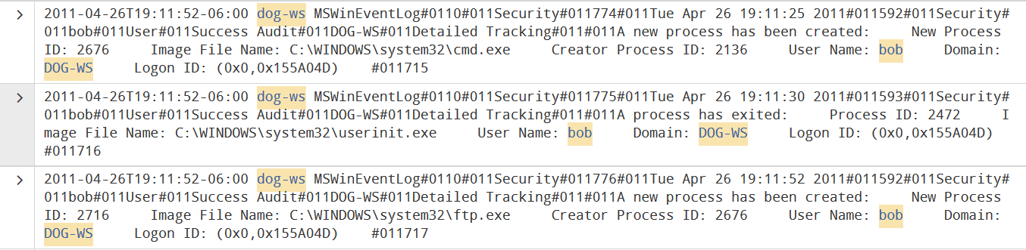
Windows Workstations Log
Restart search on workstations.log, and focus on 192.168.30.101 (dog-ws) and 3389 connections
Click ‘dog-ws’ to add in search phrase
In Windows log, RDP logon correspond to ‘logon Type: 10”
It is the same user name ‘bob’, whose password was cracked before
And the account runs ‘cmd.exe’, then runs ‘ftp.exe’ (who he ftp with?)

Slide 24
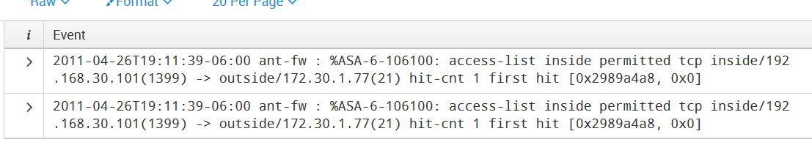
Firewall Log
Focus on 192.168.30.101 sending ftp connections out, use the firewall log (firewall.log)
Thus choose fw_src_ip and select 192.168.30.101
Thus the remote ftp server is 172.30.1.77

Slide 25
Afterwards Response
Containment/Eradication:
Rebuild the two compromised machine, 10.30.30.20 (in DMZ) and 192.168.30.101
Change all passwords related to above two PCs
Limite DMZ access to internal subnet
For example, disable RDP from DMZ to internal sub
Block outbound FTP or other not needed ports
Consider two-factor authentication to remove password guessing attack risk

Slide 26
Additional Sources of Evidence
Network flow data
Then we will know what has been transferred in the outgoing FTP connection to attacker’s ftp server
Hard drives of the two compromised machines

Slide 27
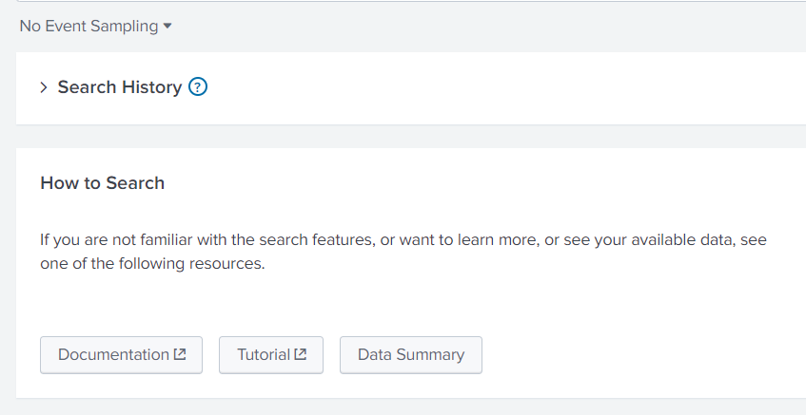
Splunk Multiple Dataset Issue
If you have imported multiple dataset before, you can choose which dataset to work on by:
Click “splunk>enterprise” at the left-up corner (home)
Select “data summary” button under “how to search”

Slide 28
Splunk Timestamp Issue
You should be aware that most log files' timestamp field contains the time zone information. When Splunk extracts the time, if your computer's time zone is different from the time zone specified in the log file, the extracted time will be different to always reflect your local time.
The time under the 'event' field is the original time text in the log; while the time under the 'time' field is what Splunk extracted.

Slide 29
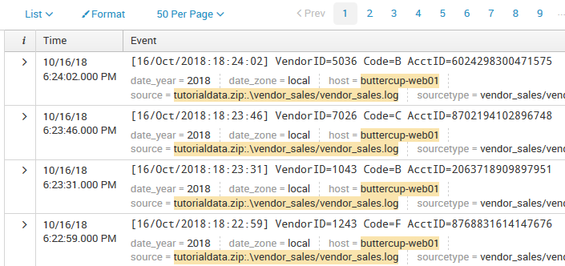
Splunk Timestamp Issue - Example
Example: let us use the “vendor_sales.log” in the ‘tutorialdata.zip’ dataset used in introduction slides
The data log was recorded on US Eastern time
If my computer is also US Eastern time (UTC-05:00), the most recent events are shown as:

Slide 30
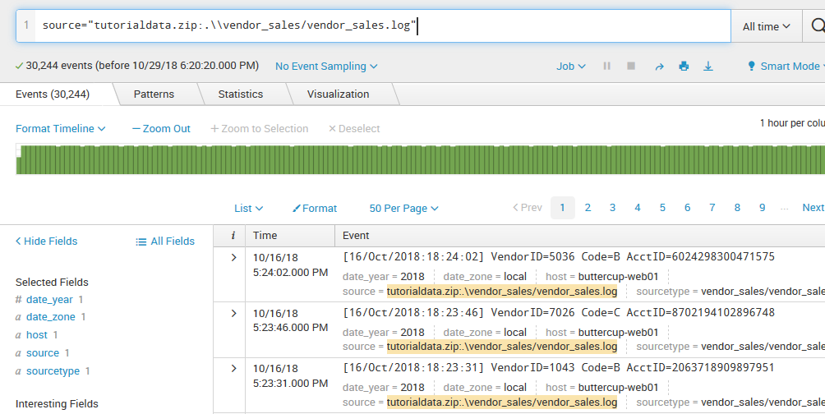
Splunk Timestamp Issue - Example
If my computer is adjusted to be US Central Time (UTC-06:00), restart Splunkd, then the most recent events are shown (after reload the dataset in splunk):

Slide 31
Note: Splunkd start/stop/restart service:
https://docs.splunk.com/Documentation/Splunk/8.0.0/Admin/StartSplunk
In Mac, you can right click Splunk icon to shutdown/restart
Another simpler way: in Splunk GUI (webpage), click on top of webpage the “setting”→”server control”, then restart splunk
How to choose an existing dataset in Splunk to start searching?
Click the left-top “Splunk-Enterprise” home log
Click “Search – Reporting” left panel button
Click “Data summary” under how to search field
Select the “host” of the dataset you want to work with

